Slide 1
2020-21 Unaudited Actuals
Presented to the Board of Trustees on
September 14, 2021

Slide 2
Key Information for 2020-21 Unaudited Actuals
Deficit spending: -$588,481. The Adopted Budget projected a deficit of -$3,714,742 for the 2020-21 Unaudited Actuals.
Reserve Assignments of $4,120,000 met
43% of the $1,253,733 Restricted Ending Fund Balance is tied to earmarked COVID funded programs
Final Basic Aid Supplemental allocation: $2,161,347

Slide 3
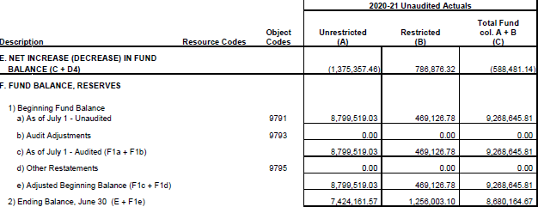
Fund 01 General Fund
The General Fund is the main operating fund of the District’s financial activities.
It is used to account for the ordinary operations of the District.
All transactions except those accounted for in other special designation funds are accounted for in this fund.
Beginning Fund Balance: $ 9,268,645.81
Ending Fund Balance: $ 8,680,164.67
Change: -$588,481.14

Slide 4
General Fund Revenues
 | Dollars per ADA | Total Amount
LCFF Sources | $ 12,123.92 | $ 8,933,391
Federal Revenue | $ 600.06 | $ 442,145
State Revenue | $ 1,693.58 | $ 1,247,899
Local Revenue | $ 422.37 | $ 311,220
TOTAL REVENUES | $ 14,839.93 | $ 10,934,654
Transfers In & Others | $ 1,885.08 | $ 1,389,000
Total Resources | $ 16,725.01 | $ 12,323,654
Final ADA: 736.84,
740.33 projected for 2021-22

Slide 5
General Fund Expenditures
Expenditures | Dollars per ADA | Total Amount
Certificated Salaries | $ 6,286.91 | $ 4,632,448
Classified Salaries | $ 1,660.12 | $ 1,223,246
Employee Benefits | $ 3,170.64 | $ 2,336,253
Books and Supplies | $ 741.97 | $ 546,710
Services and Other Op Ex | $ 1,174.35 | $ 865,306
Capital Outlay | $ 38.31 | $ 28,231
Other Outgo - excluding transfers | $ - | $ -
Other Outgo - transfers | $ - | $ -
TOTAL EXPENDITURES | $ 13,072.30 | $ 9,632,193
Transfers Out & Other | $ 4,451.36 | $ 3,279,942
Total Uses | $ 17,523.66 | $ 12,912,135
$ 8,191,946
Note: Transfers out includes contributions to Fund 12 (Child Development) & Fund 13 (Cafeteria), which were used to cover Salaries & Benefits housed in those funds.

Slide 6
Deficit Spending
Deficit spending: When District Expenditures outpace Revenue allocations.
Significant contributions to Fund 12: Child Development ($118k), and Fund 13: Cafeteria Fund ($47k)
Staffing costs
Additional Classified support staff on temporary status to support COVID protocols
COLA not keeping up with the increases in STRS & PERS
Transfer to Fund 40 for capital improvement projects

Slide 7
Reserve assignments, Fund 01
Assigned Amounts
Total
$4,120,0000

Slide 8
Reserve assignments, Fund 01 + Fund 17
+ Fund 17
3,432,015
The function of Fund 17 is to account for and accumulate the district’s required minimum Required Reserve for Economic Uncertainty (REU). While Fund 17 is authorized by statute, it does not meet the Generally Accepted Accounting Principals (GAAP) definition of a special revenue fund. Meaning, it functions effectively as an extension of the general fund and should be considered as such. Thus, when reviewing the district’s Unrestricted Reserves, it is important to also include Fund 17 to understand the full picture of the District’s ending financial position.

Slide 9
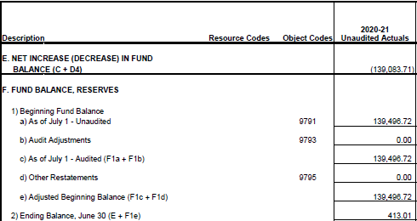
Fund 12: Child Development
The Child Development Fund was established to separately account for the proceeds from specific
revenue sources, which by law, are restricted to the financing of preschool and afterschool programs. Revenue come solely from the Beyond the Bell Tuition Fees.
Expenditures can be for salary and benefits for staff running the Child Development program, administrative costs charged, child development activities such as materials and supplies, facilities and or repair.
Beginning Fund Balance: $ 139,496.72
Ending Fund Balance: $ 413.01
Change: -$139,083.71
Note: Beyond the Bell was not running during the 2020-21 school year, but Staff remained on full salary. In total, the program ran a -$257,460 deficit, and required a $118,376 contribution from the general fund to remain solvent.

Slide 10
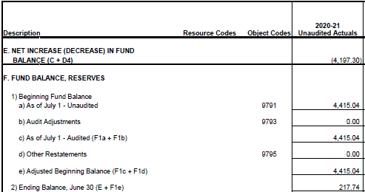
Fund 13: Cafeteria
The Cafeteria Special Revenue Fund is used to account separately for federal, state and local resources
used to operate the food service program. The principal revenues in this fund are from Child Nutrition
Program reimbursements (Federal and State), food service sales, and interest earned on the fund.
Expenditures can be for salary and benefits for staff running the Cafeteria program, administrative costs charged, cafeteria activities such as food, materials and supplies, facilities and or repair.
Beginning Fund Balance $ 4,415.04
Ending Fund Balance $ 217.74
Change: -$4,197.30
Note: The primary revenue source comes from meal reimbursements. With school closed for the majority of the year, reimbursements were 90% less than previous years, but staffing expenses remained intact. The program ran a -$51,892 deficit, and required a $47,395 contribution to remain solvent.

Slide 11
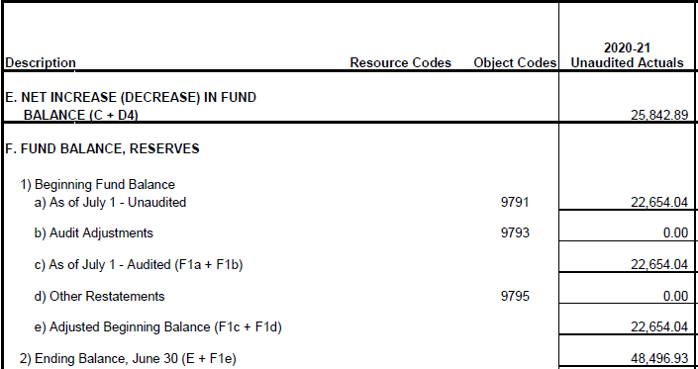
Fund 14: Deferred Maintenance
This fund is used to account separately for revenues that are restricted or committed for deferred maintenance purposes. Revenue sources include transfers from LCFF allocations, transfers from the general fund, and interest earned.
Expenditures included the Gravenstein parking lot repaving, and tree removal.
Beginning Fund Balance: $ 22,654.04
Ending Fund Balance: $ 48,496.93
Change: $ 25,842.89

Slide 12
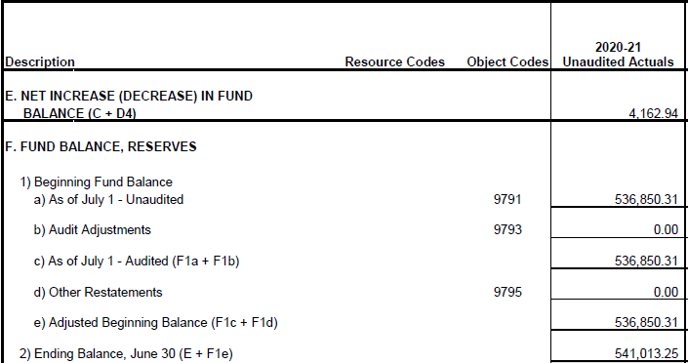
Fund 17: Special Reserve other than Capital Outlay
This fund is used as a reserve for the State required minimum required reserve of 5% for capital improvement projects. This is a special
fund in which funds can only be accumulated or transferred to another fund.
There can be no expenditures from this fund. The only income is through interest earned. The balance in this fund is available to cover unexpected costs, like Special Education and Transportation, which arise at short notice.
Beginning Fund Balance: $ 536,850.31
Ending Fund Balance: $ 541,013.25
Change: $ 4,162.94

Slide 13
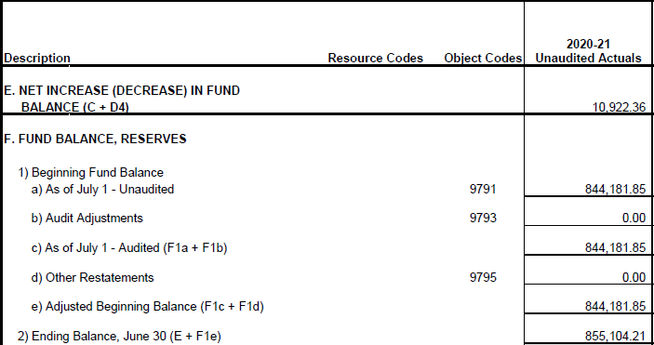
Fund 20: Other Postemployment Benefits
The Special Reserve Fund for Postemployment Benefits (OPEB) may be used to separately account for the amounts the District has earmarked for the future cost of retiree benefits, but has set in an irrevocably trust. All Revenue is currently derived from interest.
Per the current GASB 75 Actuarial summery, the District’s Net OPEB Liability is risked at $895,020.
Beginning Fund Balance: $ 844,181.85
Ending Fund Balance: $ 855,104.21
Change: $ 10,922.36

Slide 14
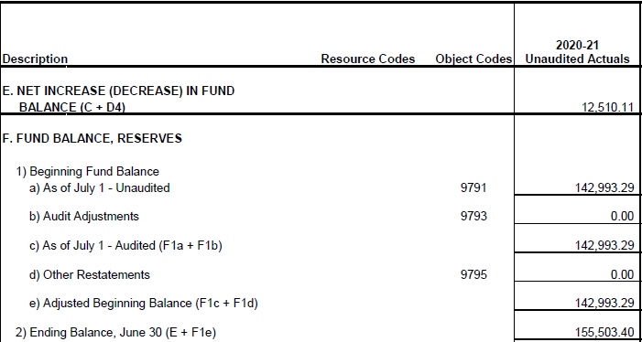
Fund 25: Capital Outlay
This fund is used to account separately for monies received from developer fees, both commercial and residential, collected at the time building permits are issued, and interest.
Beginning Fund Balance: $ 142,993.29
Ending Fund Balance: $ 155,503.40
Change: $ 12,510.11

Slide 15
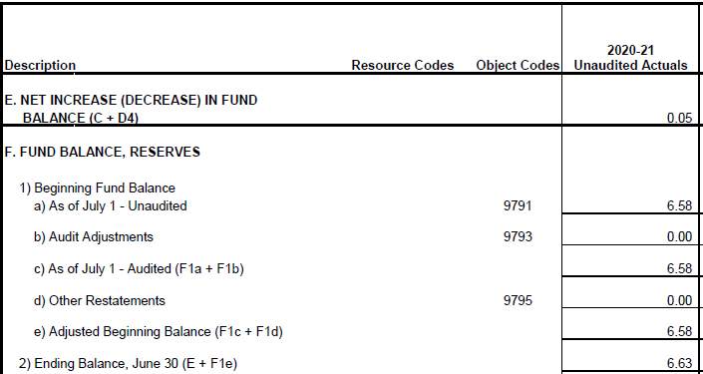
Fund 35: County Schools Facilities Fund
The County School Facilities Fund is established by to receive apportionments from the State for new school facility construction and or school modernization projects. This fund has a small residual balance from previous State projects.
Currently, the District has applied for school modernization funds, expected allocation date is spring 2023. These funds will be used for future modernization projects per the Facilities Master Plan.
Beginning Fund Balance: $ 6.58
Ending Fund Balance: $ 6.63
Change: $ 0.05

Slide 16
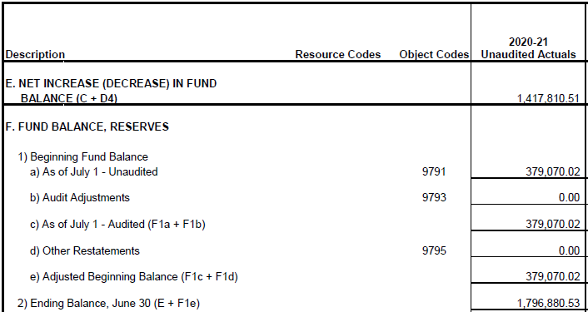
Fund 40: Special Reserve for Capital Facilities
The Special Reserve for Capital Outlay exists primarily to provide for the accumulation of General Fund
monies set aside for large Capital projects as outlined in the Facilities Master Plan.
The District made a significant contribution of $1,700,000 in the 2020-21 fiscal year to fund the upcoming Hillcrest Heat Mitigation Project and District Office Relocation Project slated to take place during the summer of July
2021.
Beginning Fund Balance: $ 379,070.02
Ending Fund Balance: $ 1,796,880.53
Change: $ 1,417,810.51

Slide 17
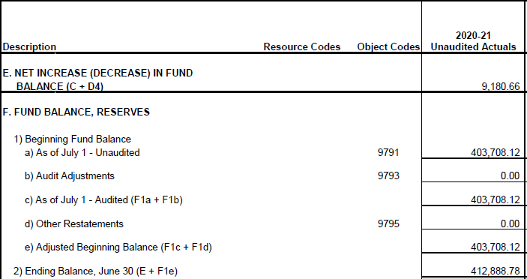
Fund 51: Bond Interest and Redemption Fund
The Bond Interest and Redemption Fund exists as a holding account for the collection of payments made
by property owners for bond payments. This account is held at the County Treasury and the District receives an accounting from the County for our annual reporting. Revenue is derived from interest only.
Beginning Fund Balance: $ 403,708.12
Ending Fund Balance: $ 412,888.78
Change: $ 9,108.66

Slide 18
Supplementary Forms
Supplementary Forms are a requirement at the Unaudited Actuals reporting period. Below is a brief description of the intent of each Form.
Form A: Attendance – shows the final ADA for the 2020-21 school year as well as what is projected at the Adopted Budget
From Asset – shows how the District’s large assets (Land, Buildings, and Equipment) are depreciating according to the Auditors actuarial tables.
Form CEA: Current Expense Formula/Minimum Classroom Compensation – calculation showing the District spent the minimum requirement of 68.68% of all of its expenditures on salaries and benefits.
Form Debt – shows the District’s general obligation Bond payments, principal and interest.
Form ESMOE: Every Student Succeeds Act Maintenance of Effort Expenditures – calculation showing the District spent at least as much as the previous year on students.
Form ICR: Indirect Cost Rate – a calculation of the District’s Indirect Cost Rate it can charge programs for administrative fees
Form L: Lottery – detail accounting of how the District spent its unrestricted and restricted Lottery allocation
Form PCR: Program Cost Report – shows the distribution of how the District spent money between the different education program types (regular education, special education, independent study, etc.)
Form PCRF: Program Cost Report Schedule of Allocation Factors – designation of ETE per education program type
Form SIAA: Summery of Interfund Activities – List of the transfers made between the Districts various funds
Form TRC: Technical Review Checks – shows the accurate reporting of SACS documents.

Slide 19
Questions?

