Slide 1
2022-23 Adopted Budget
Presented to the Board of Trustees on
June 7, 2022
Katie Anderson, CBO
David Rose, Superintendent

Slide 2
Key Budget Information for the 2022-23 Adopted Budget
Recommended Certification Status: Positive
Enrollment: 775
Projected Average Daily Attendance (ADA): 731.91
Basic Aid Supplemental (BAS): $ 950,000
Revenue: $ 10,462,780
Expenditures: $12,543,943
Deficit spending is projected to be -$ 2,081,163
Ending Fund Balance = $ 5,211,195
District Reserve Assignments: $ 4,100,000
Unassigned Balance = $ 56,457
No contributions planned to support other Funds

Slide 3
COLA
The projected Cost of Living Adjustments estimates are provided from School Services of California. Current year LCFF revenue is based on a 6.56 COLA.
COLA will also be applied to special education, child nutrition, mandated block grant, and foster youth programs. In previous years, COLA only applied to LCFF funding.
Currently still being debated by the state legislator is an additional $2 - 10 billion in ongoing funding to Proposition 98 to increase the LCFF base funding above the 6.56 COLA.

Slide 4
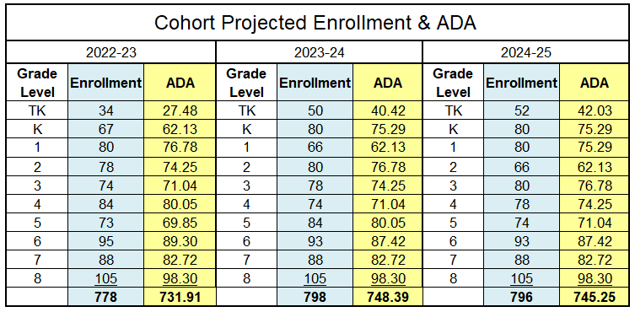
Average Daily Attendance & Enrollment
Enrollment and ADA Projections:
Cohort projection modeling used. TK ADA projected at 80% of enrollment for all years.
Enrollment: 778
ADA: 731.91 including SCOE and NPS ADA
The estimate Enrollment/ADA percentage used in the budget is 94.07%.
Unduplicated Pupil Percentage used for Title funding and our supplemental calculation is estimated at 38.49% for the Charters and 31.13 for the District.

Slide 5
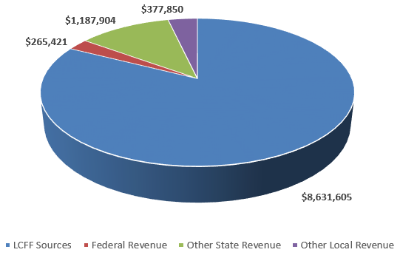
General Fund Revenue Sources
LCFF sources include state revenue generated from ADA, Education Protection Account, Property Taxes, and Basic Aid Supplemental
Federal Revenues include GEER II, ESSSER II & III, Title I, II & IV Funding, and Funding for Special Education
Other State Revenues include Lottery, Mandated Block Grant, Extended Learning Opportunities Program, Educator Effectiveness Block Grant, Special Education Early Intervention Preschool Grant, Special Education Learning Recovery Grant and STRS-on-Behalf
Other Local Revenues includes GPA donations, field trip donations and interest
Not included in revenue projections: Proposed funding from the Governor’s May Revision
No transfers in planned for any years

Slide 6
General Fund Expenditures
Salary & Benefits categories have been updated to reflect budgeted expenditures and future incumbrancers for the 2023 June Extended Learning Opportunities Program (Jumpstart) . Increases to salaries and benefits reflect negotiated settlements. Salary & Benefits represent 84.4% of all expenditures.
Routine Restricted Maintenance funding used to support the Hillcrest Re-Roofing Project.
No transfers out planned for any years

Slide 7
Contributions
Programs requiring contributions from the General Fund:
Required Routine Restrict Maintenance - $357,537
Special Education - $229,060
Gravenstein Charter $ 1,150,000
Hillcrest Charter $ 1,300,000
Field Trips - $131,000
Total Planned Contribution = $3,167,711

Slide 8
Deficit Spending
Deficit spending is projected in all three years:
2022/23 $ (2,081,163)
2023/24 $ (2,020,723)
2024/25 $ (1,918,539)
Deficit spending is caused by:
Ongoing contributions to support ongoing deficit spending at Gravenstein Elementary School Charter ($1,150,000), Hillcrest Middle School Charter ($1,300,000). Expenditures outpace LCFF Funding per student.
Increases in STRS & PERS significantly impact the gains from COLA. 75% of the COLA will go towards STRS & PERS increases in the 2022/23 year.
STRS rates% Yearly Increase PERS Rates % Yearly Increase
2022-23 increase of 19.10 % $ 122,650 2022-23 increase of 25.37 % $ 105,352
2023-24 projected at 19.10 % $ 187,438 2023-24 projected at 25.20 % $ 21,852
2024/25 projected at 19.10 % $ 21,048 2024-25 projected at 24.60 % $ 0
Additional Certificated staff time supporting the Enrich! program for all District students

Slide 9
Reserve assignments for fiscal stability
Required to be Positive
Positive Certification is Recommended

Slide 10
Other Forms (SACS) AND ADDITIONAL NOTES
Form CB: District Certification of Adopted Budget
Form 01 CS: Standards and Criteria
Form CC: Worker’s Compensation Certification
Form ICR: Indirect Cost Rate
5.71%
Form ESMOE: Every Student Succeeds Act Maintenance of Effort Expenditures
The District will expend as much as last year on all students
Form A: Attendance
Other Notes
The District is currently in negotiations with the Classified bargaining unit. The all budget and MYP information does not include any assumed settlements. Please see Appendix A for more information on the Governor’s Proposed additional funding scenarios.

Slide 11
Questions?

